Slide 1
Eureka WUI Structure Burn Tests
Summary of Project

Slide 2
Introduction
In early June of 2024, the Disaster Lab conducted a structure fire test to evaluate the fire resistant potential of several different exterior and interior coatings and building coverings
In collaboration with USFS, CalFire Humboldt Del Norte Unit, CalPoly Humboldt, Flame Security International, North Folk Lumber, and Squishy Robotics
In mid November of 2024, the Disaster Lab conducted a pile burn test to further investigate heat exposure and radiant heat transfer

Slide 3
Structure Burn Test
Six small ADU-size structures (sheds) were set up using primarily timber
Control unit
Unit with exterior fire resistant paint, membrane window covering, and surrounded by hay covered in landscape fire retardant
Unit with exterior quick-spray fire resistant coating for emergency applications
Unit with internal fire resistant coating applied to interior walls and surfaces with standard US furniture inside
All units were exposed to flames from large torches for 10 minutes
Notes:
We set up six small ADU-size structures (Tuff Sheds), using primarily timber products. Two units were controls (one for exterior coatings, another for interior), and the remaining had different fire resistant coatings and materials applied: 1) exterior fire resistant paint and a membrane window covering; 2) exterior fire resistant paint, a membrane window covering, and a land-scape fire retardant applied to hay scattered around the perimeter; 3) a quick-apply “spray and go” fire resistant coating for emergency applications applied to the exterior of a structure; and 4) an internal fire resistant coating applied to interior walls and surfaces with standard US furniture within. All of the units were exposed to flames from large torches for 10 minutes. We recorded the results with thermocouples, a research IR camera, an optical GoPro, and a gas and particulate sensor system. Now we need to match up the time-series from each sensor with each other and then analyze the detection ranges, heat exposure curves, and resulting emissions from each structure.

Slide 4
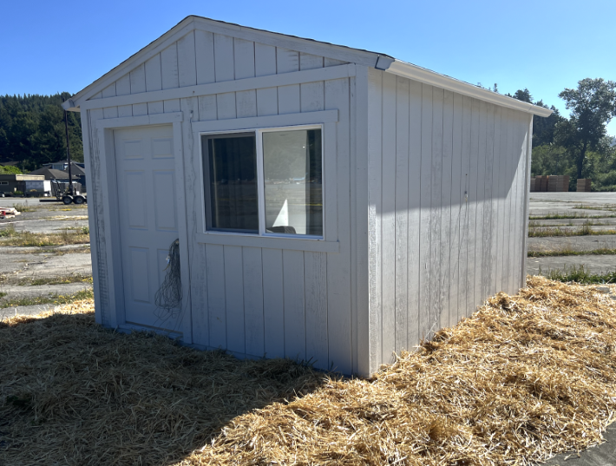
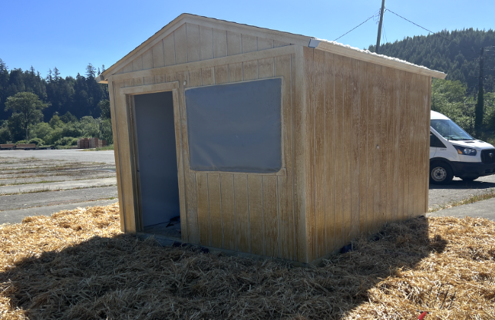
Structures

Slide 5
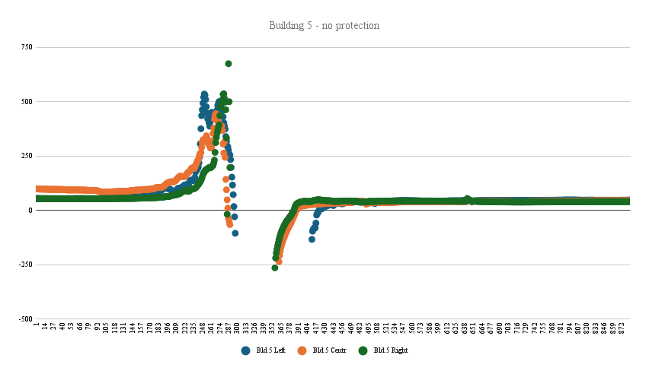
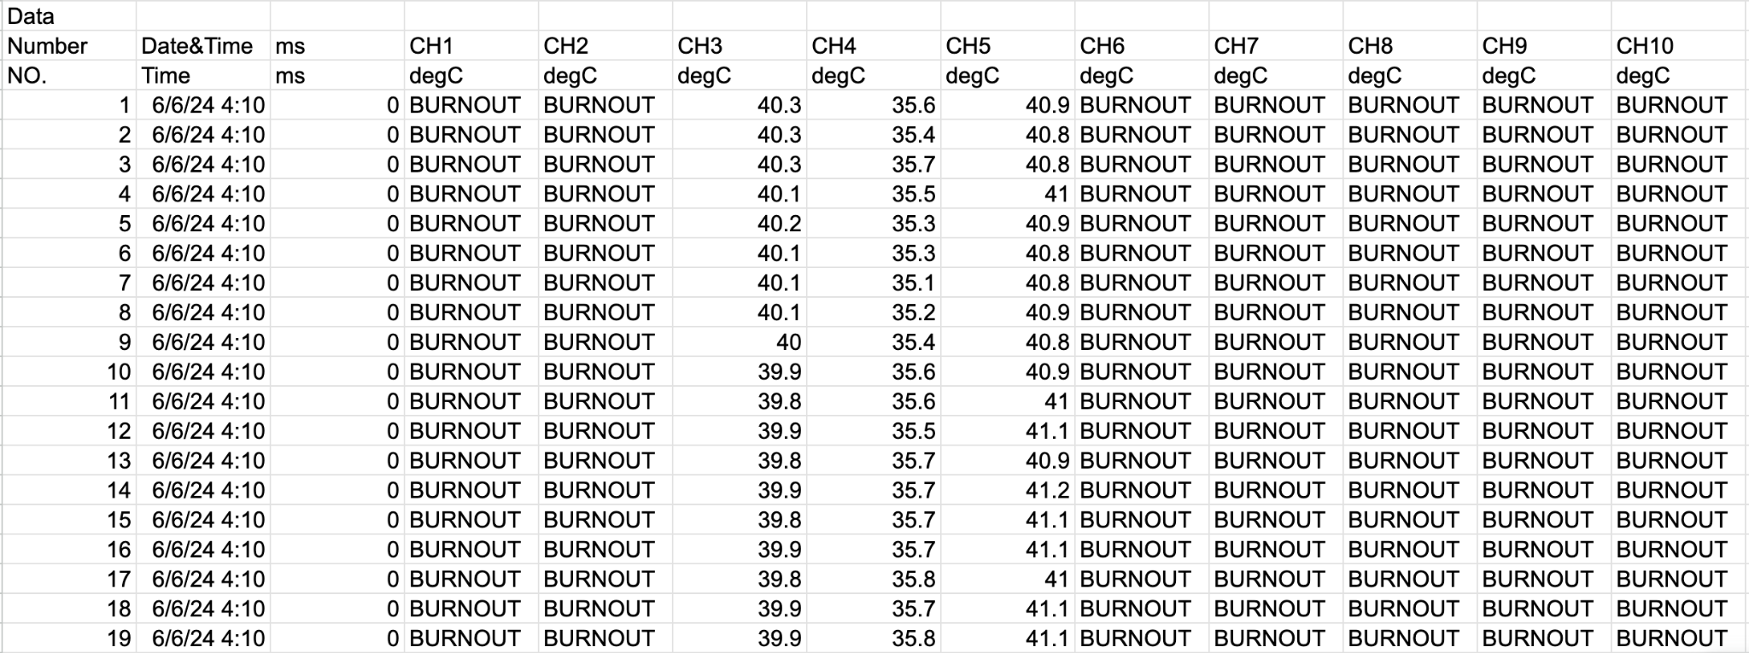
Data - Disaster Lab
Thermocouple sensors: temperature data

Slide 6
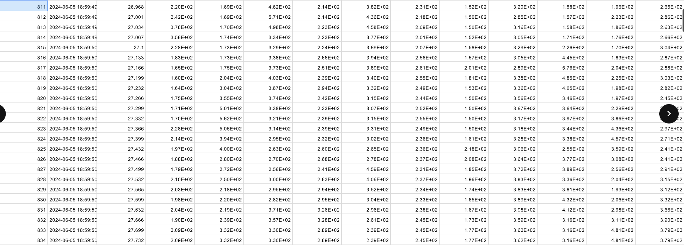
Data - Cal Poly Humboldt
Infrared camera - temperature data

Slide 7
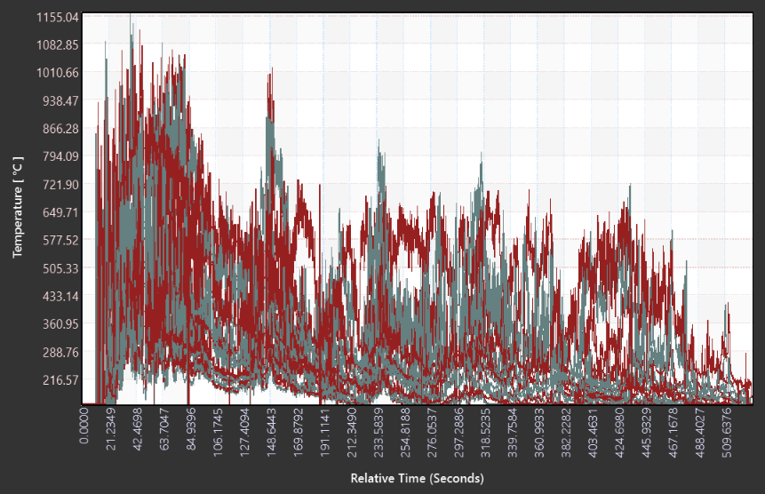
Data - Cal Poly Humboldt

Slide 8
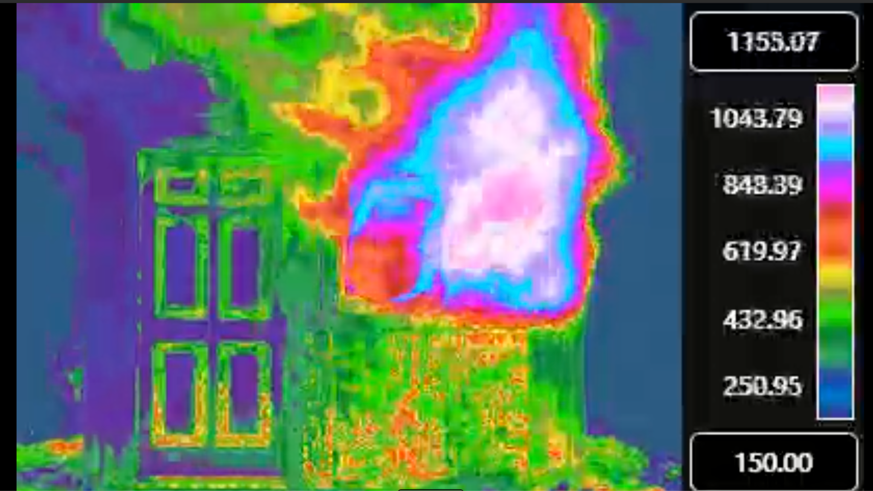
Data - Cal Poly Humboldt

Slide 9
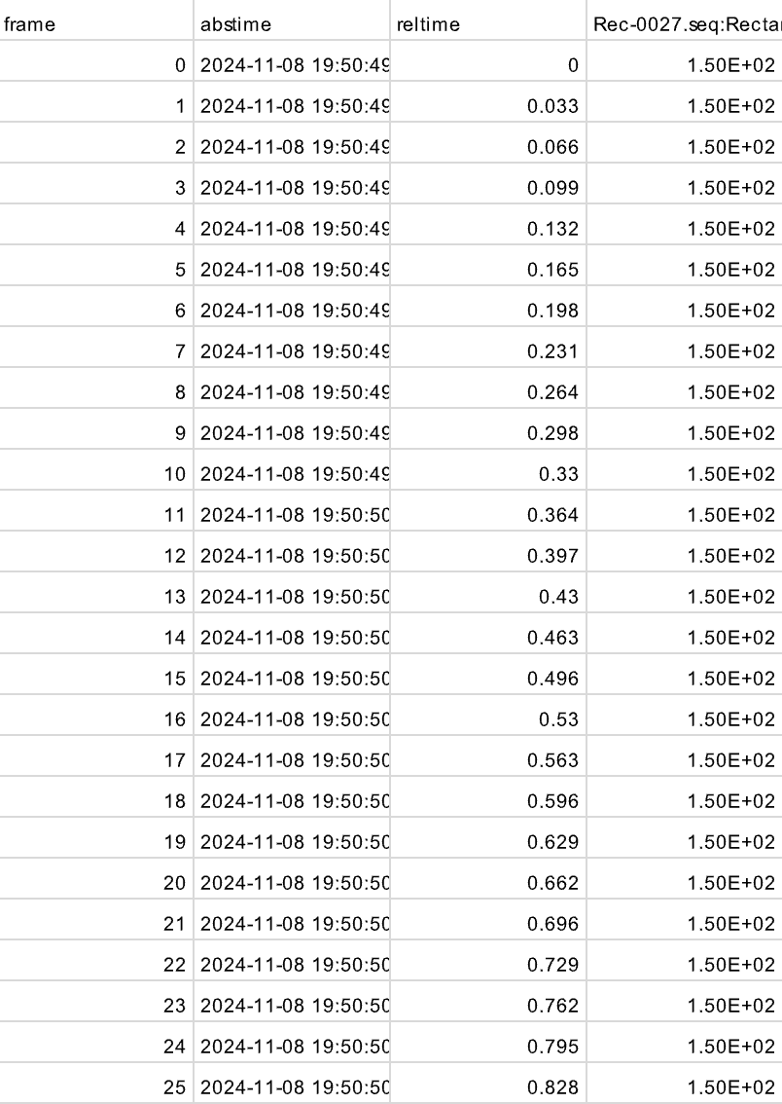
Pile Burn Test
Infrared camera - temperature data

Slide 10
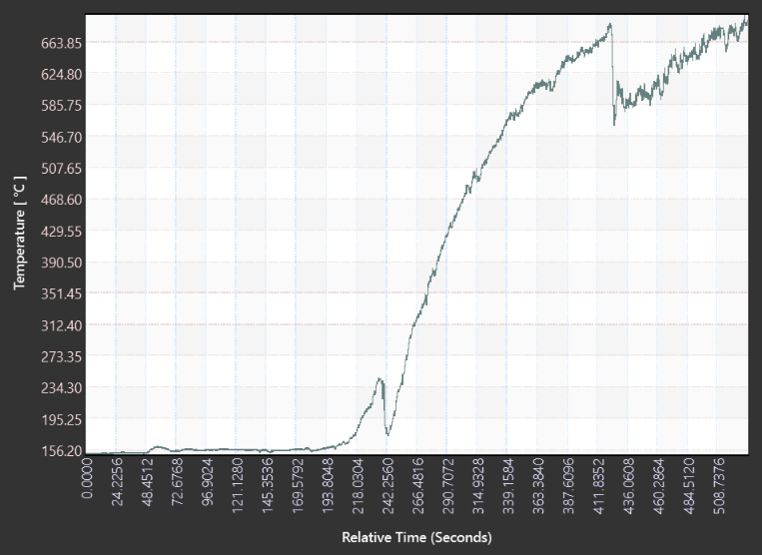
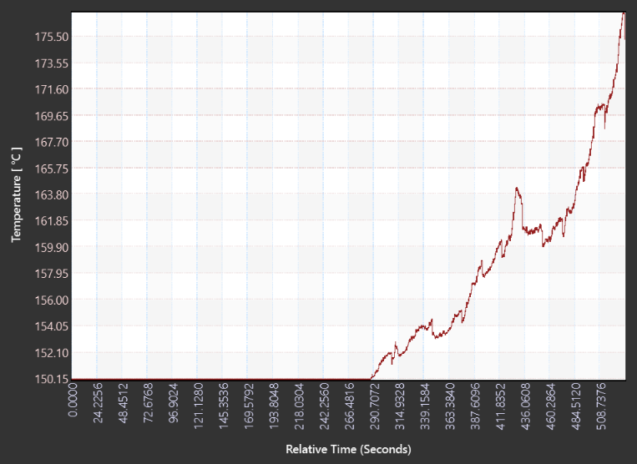
Pile Burn Test
Pile
Shed

Slide 11
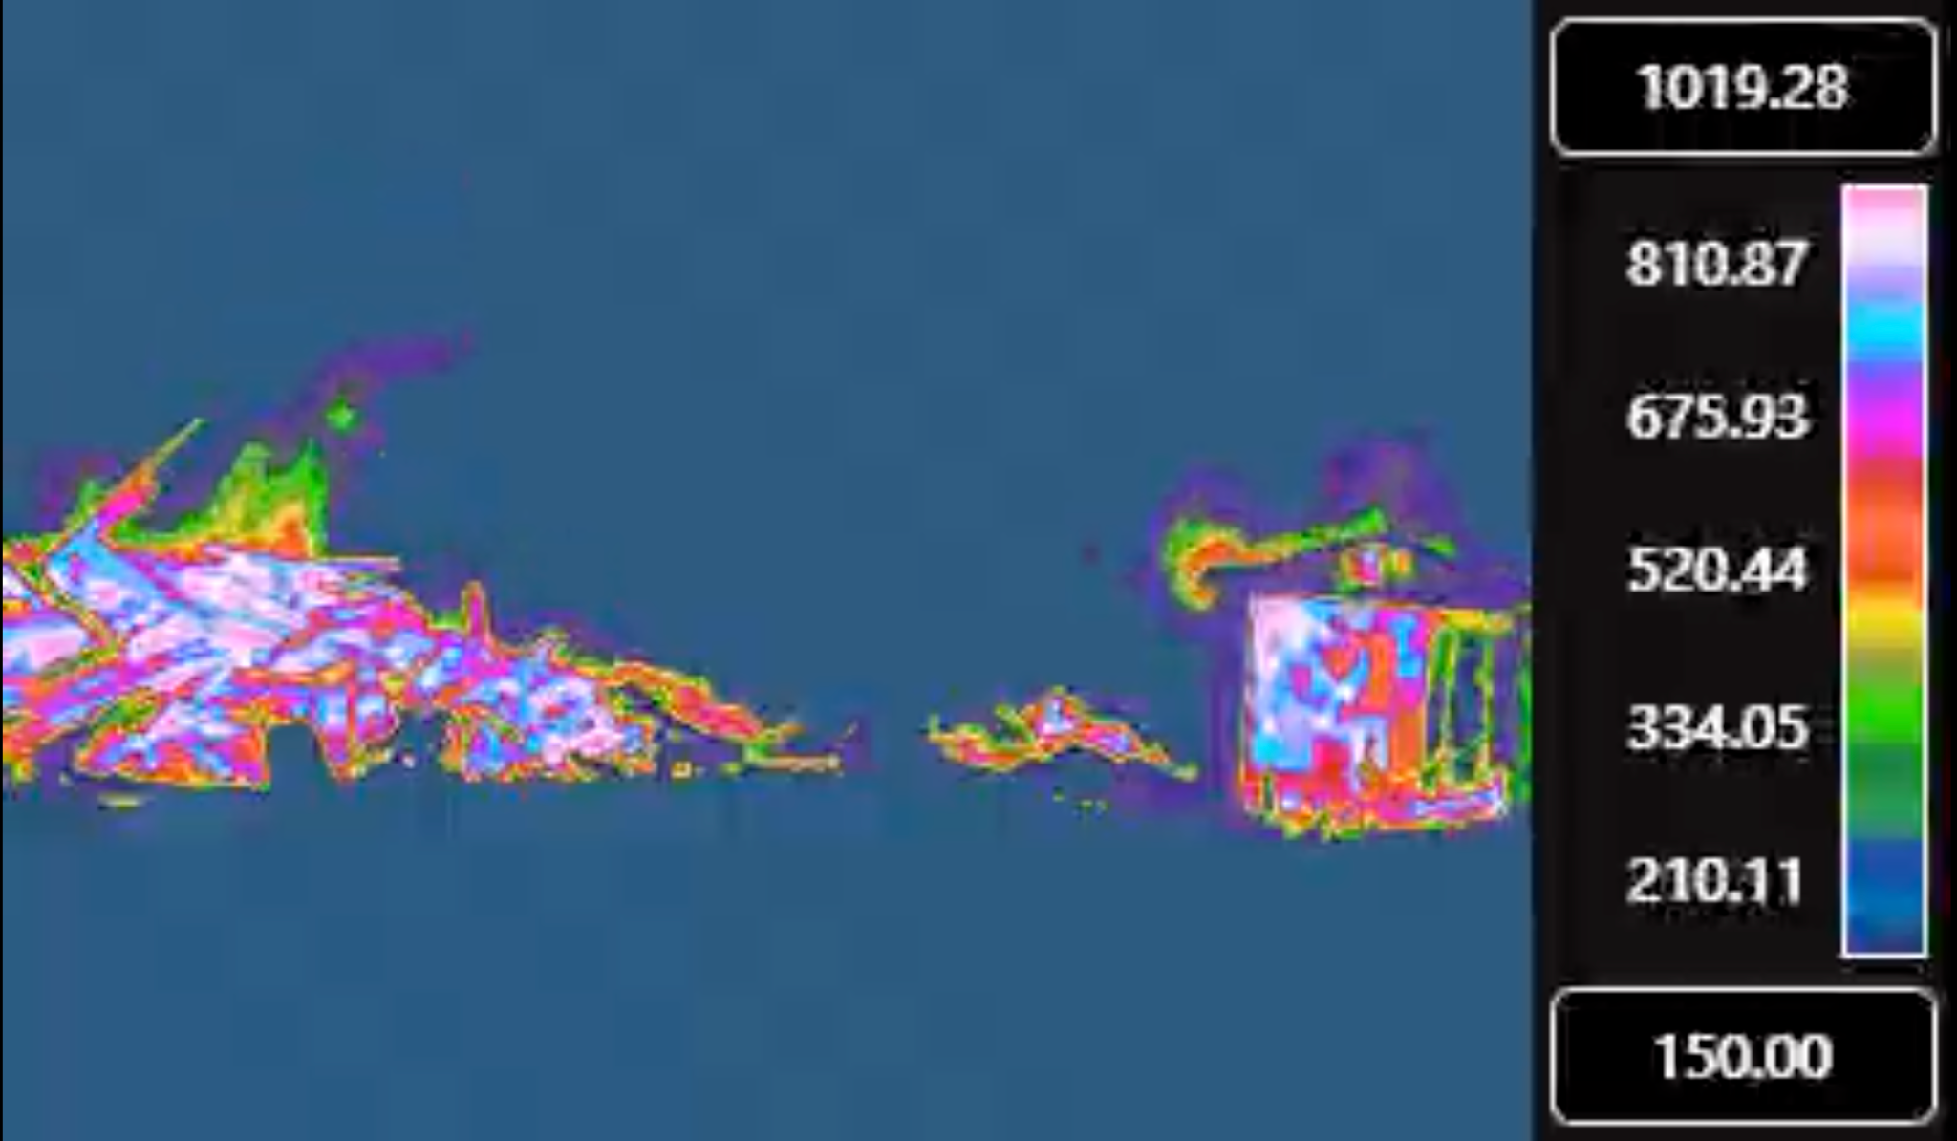
Pile Burn Test

